Slide 1
Chapter 8
Semantic Search and Retrieval-
Augmented Generation
From the book Hands-On Large Language Models

Slide 2
Overview of Semantic Search and RAG
The top three approaches for using language models in search are:
Dense Retrieval
Reranking
RAG

Slide 3
Dense Retrieval
Dense Retrieval systems rely on embeddings.
Embeddings are lists of float values that numerically represent the semantic meaning of text.
These values serve as coordinates in a high-dimensional vector space, where semantically similar texts are positioned close together.
This is important to remember (discussed multiple times in earlier chapters) because embeddings are integral to the search functionality of semantic search systems.

Slide 4
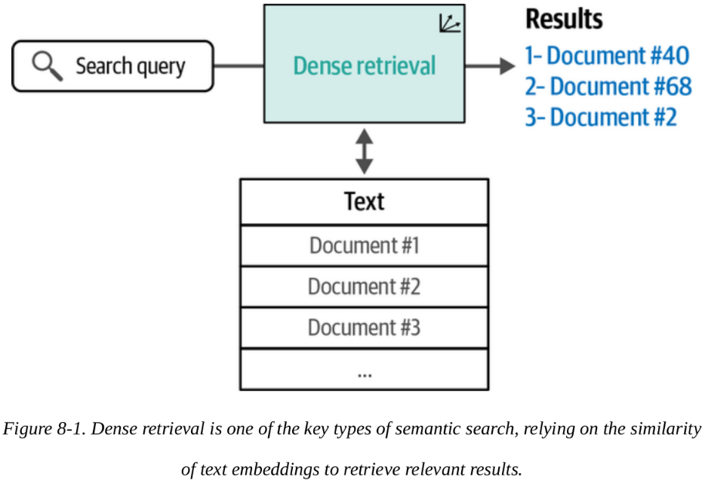
Dense Retrieval

Slide 5
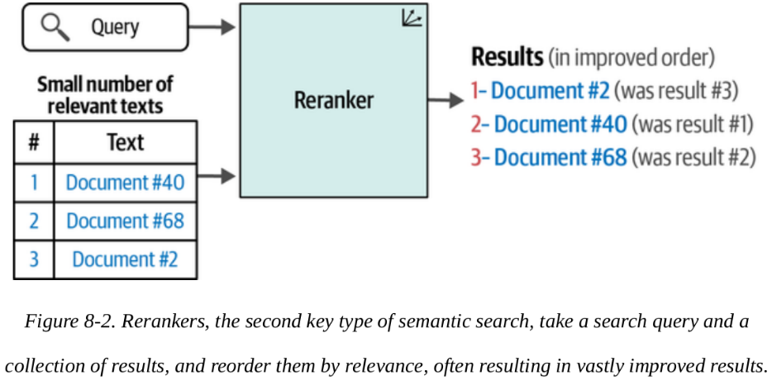
Reranking
Search systems contain multiple steps.
A reranking language model is one of these steps.
Reranking language models are tasked with scoring the relevance of a subset of results against the query.
See the illustration

Slide 6
RAG
Generative search is a subset of a broader type of category of systems called RAG systems.
A reranking language model is one of these steps.
Unlike just LLMs, RAG Systems use search capabilities to
reduce hallucinations,
increase factuality
ground the generation model on a specific dataset.

Slide 7
RAG

Slide 8
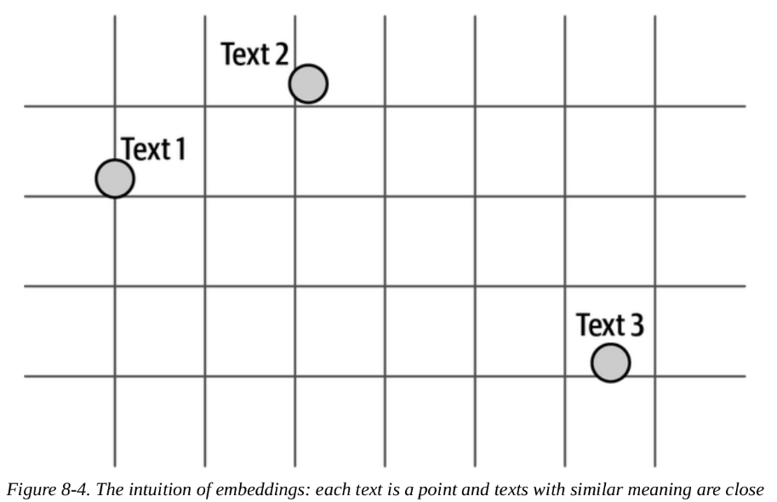
Semantic Search with Language Models
As mentioned earlier, we can think of the values in an embedding as points in a space.

Slide 9
Semantic Search with Language Models
For example, we know that distances between data points could be interpreted as similarity.
Considering that, and the illustration, should text 3 even be returned as a result?
The answer depends on the nature of the system and the choice of you or the designer.

Slide 10
Semantic Search with Language Models
Are query and its best result always semantically similar (and are close to each other in the embedding space)?
Not necessarily.
Language models need to be trained on question-answer pairs to become better at retrieval.
We will see this with code in the next slides

Slide 11
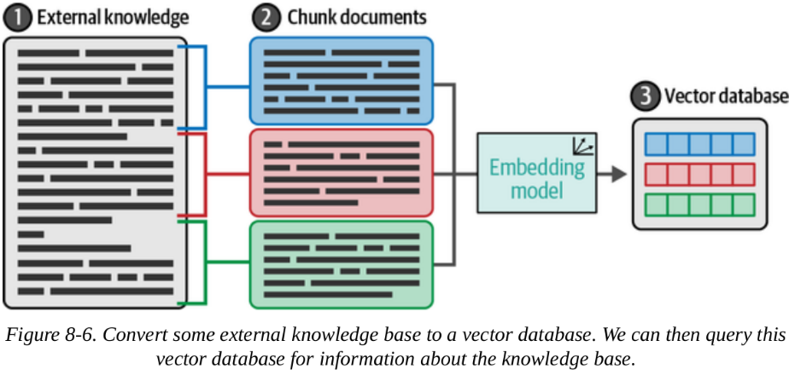
Semantic Search with Language Models
Below is an illustration of using external knowledge in the vector database.

Slide 12
Semantic Search with Language Models
Dense Retrieval Example
Here, we'll test and use embeddings to search for text. We will:
Get the text we want to make searchable and apply some processing to chunk it into sentences.
Embed the sentences.
Build the search index.
Search and see the results.

Slide 13
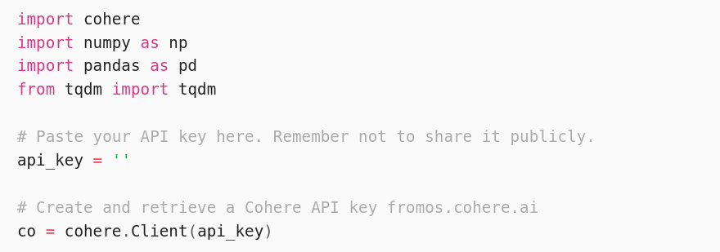
Semantic Search with Language Models
Dense Retrieval Example

Slide 14
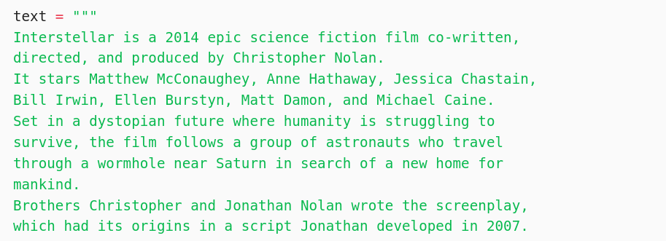
Semantic Search with Language Models
Getting the text archive and chunking it
Let's use the first section of the article on the film Interstellar.
The rest of the text can be viewed in the Notes or in the book.

Slide 15
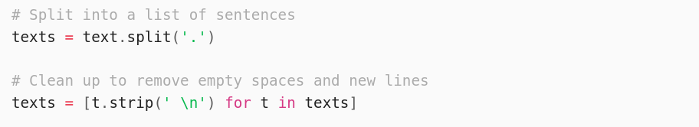
Semantic Search with Language Models
Getting the text archive and chunking it
We’re using the first section of the article on the film Interstellar.

Slide 16
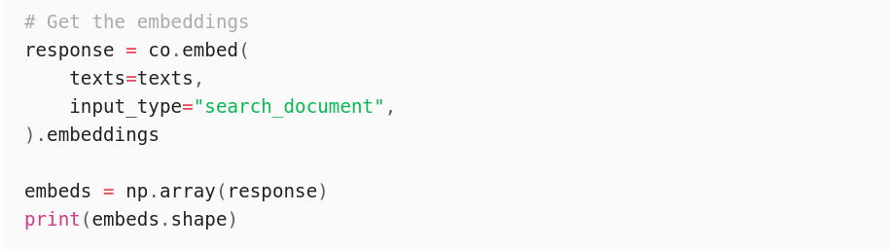
Semantic Search with Language Models
Embedding the text chunks
This outputs (15, 4096) , which indicates that we have 15 vectors, each one of size 4,096.

Slide 17
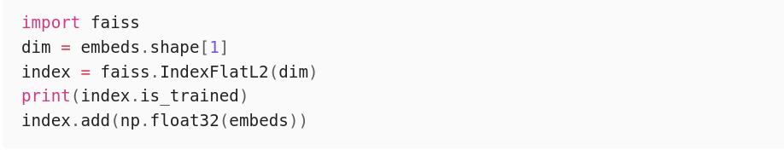
Semantic Search with Language Models
Building the search index
Before we can search, we need to build a search index.
An index stores the embeddings and is optimized to quickly retrieve the nearest neighbors

Slide 18
Semantic Search with Language Models
Search the index
We can now use it to search the dataset (Wikipedia article for
Interstellar)
We embed the query and present its embedding to the index, which will retrieve the most similar sentence.
See in the next slide the search() search function

Slide 19
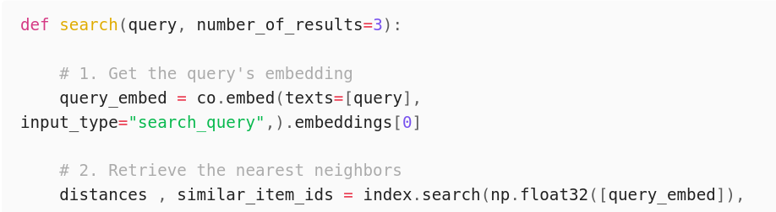
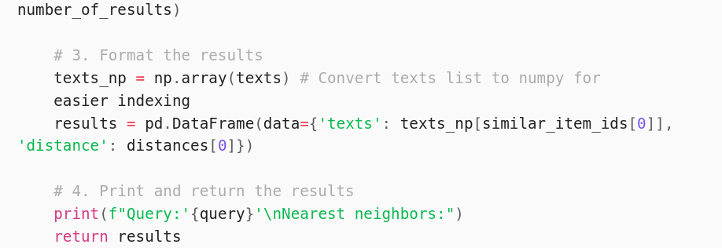
Semantic Search with Language Models
Search the index

Slide 20
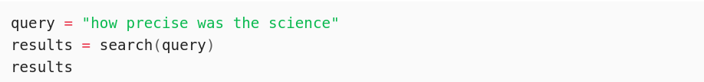
Semantic Search with Language Models
Search the index
We can now write a query and search the texts:
This outputs:
… (the rest of the output is in the next slide)

Slide 21
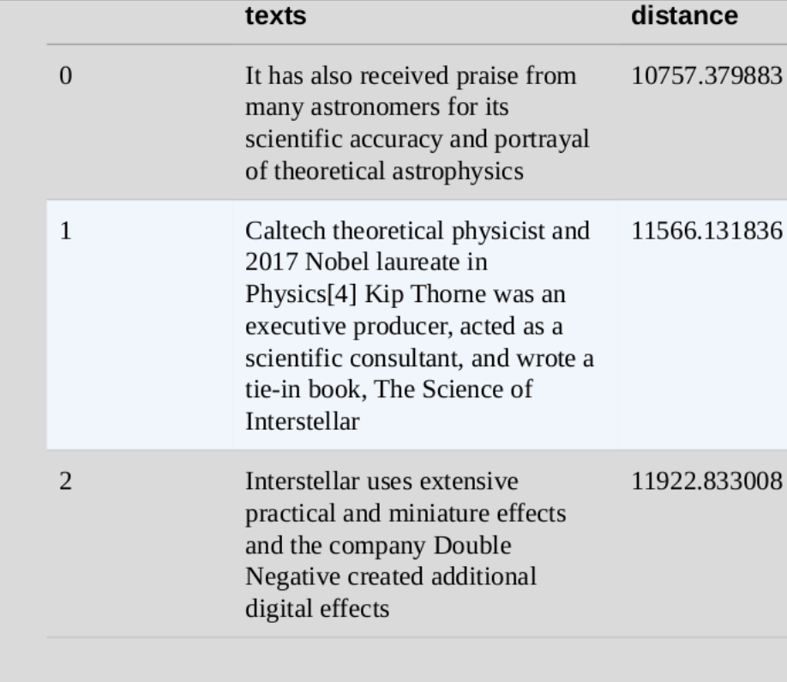
Semantic Search with Language Models
Search the index
This outputs:

Slide 22
Semantic Search with Language Models
Search the index
Looking at the results, we can see that the first one has the least distance, and so is the most similar.
We use the word ‘science’
Because we use semantic similarity, instead of keyword matching we get results of similar meaning (e.g., 'scientific..', 'theoretical astrophysics', etc.), not necessarily the same word match

Slide 23
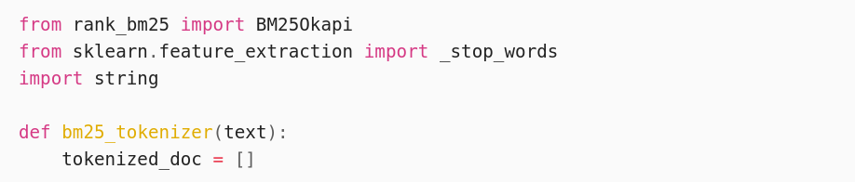
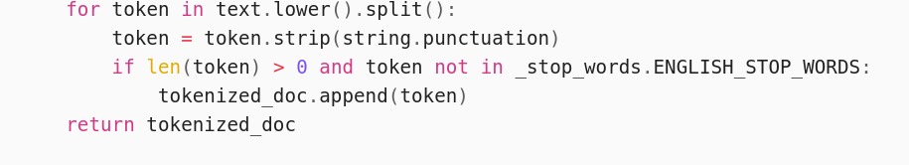
Semantic Search with Language Models
Search the index
Let's see how the BM25 (one of the leading lexical search methods) algorithm performs.

Slide 24
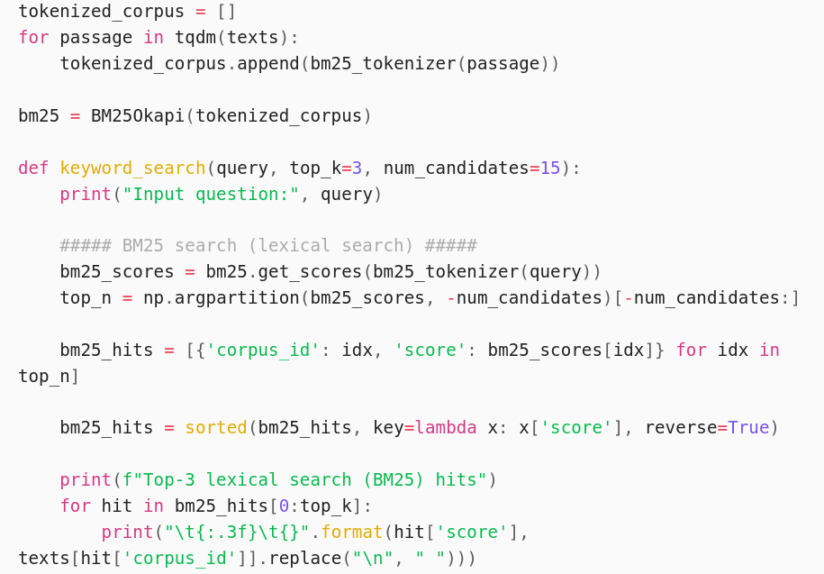
Semantic Search with Language Models
Search the index
Continuation:

Slide 25
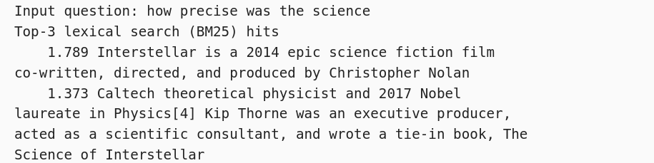
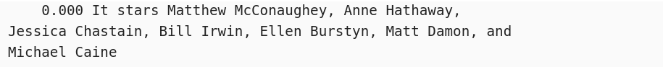
Semantic Search with Language Models
Search the index
When we search for the same query, we get a different set of results from the dense retrieval search:
Result:

Slide 26
Semantic Search with Language Models
Search the index
Because BM25 is a lexical (keyword-based) search, we see that first result does not really answer the question despite it sharing the word “science” with the query.
Result:

Slide 27
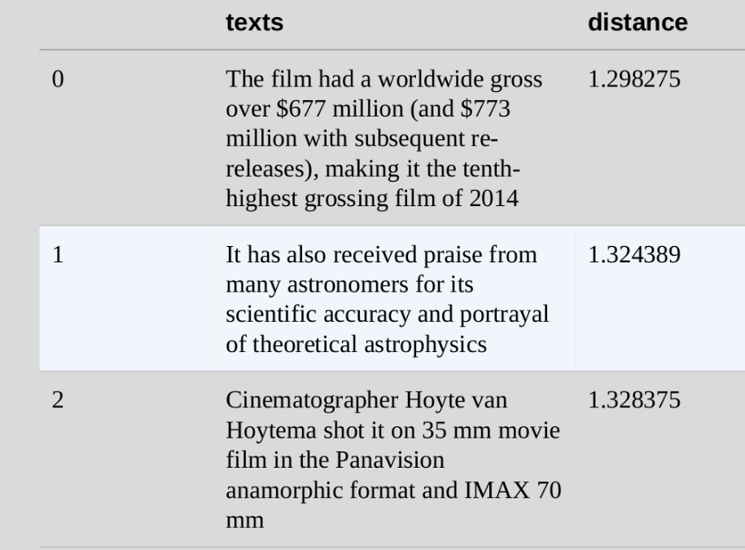
Semantic Search with Language Models
Caveats of dense retrieval
Dense retrieval always returns results, even when the documents don't contain the answer.
See the results for the query: ‘What is the mass of the moon?’
None of them answer the question.
One way to address it is to use a threshold level.

Slide 28
Semantic Search with Language Models
Caveats of dense retrieval
2. Another caveat of dense retrieval is when a user wants to find an exact match for a specific phrase, not semantic similarity.
This is why a hybrid search system (that combines keyword matching and dense retrieval) is advised instead of relying solely on dense retrieval.
3. Dense retrieval systems also find it challenging to work properly other than the ones they are trained on
4. It is hard to handle answers spanning multiple sentences. There is a trade-off between chunk size and information completeness

Slide 29
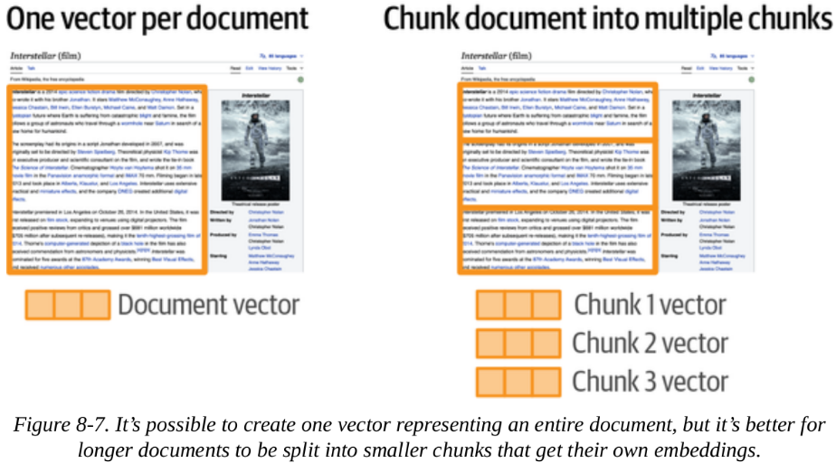
Semantic Search with Language Models
Chunking Long Texts
As we've seen in early chapters, every model has a context size limit.
This is a limitation of Transformer LMs.
This means we cannot input very long texts.
One way to solve this is by using chunking.

Slide 30
Semantic Search with Language Models
One vector per document
When doing this, there are some possibilities:
Embedding only a representative part of the text (e.g., title, beginning of text). May cause in a lot of loss of information.
Embedding the documents in chunks, embedding those chunks, and then aggregating (averaging) those chunks into a single vector.
Results in a highly compressed vector that loses a lot of the information of the document.

Slide 31
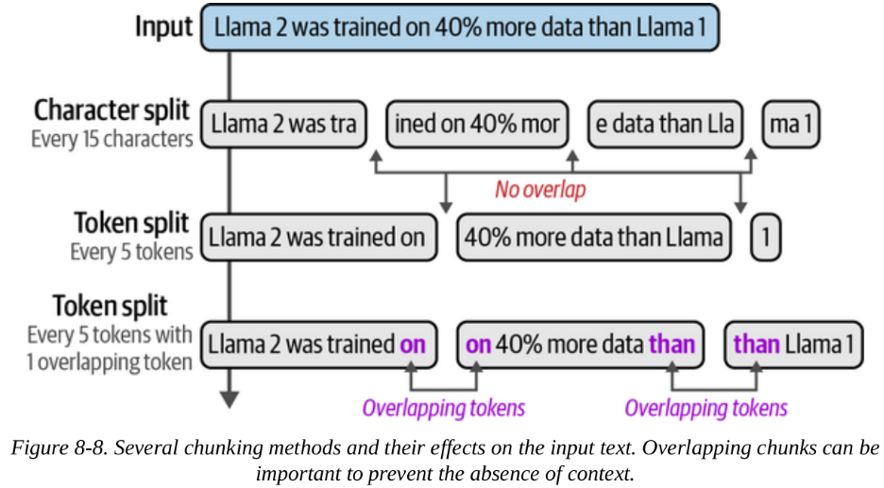
Semantic Search with Language Models
Multiple vectors per document
This is basically chunking the document into smaller pieces, and embedding those chunks, without aggregating them.
Because it has full coverage of the text, it leads to a more expressive search index.

Slide 32
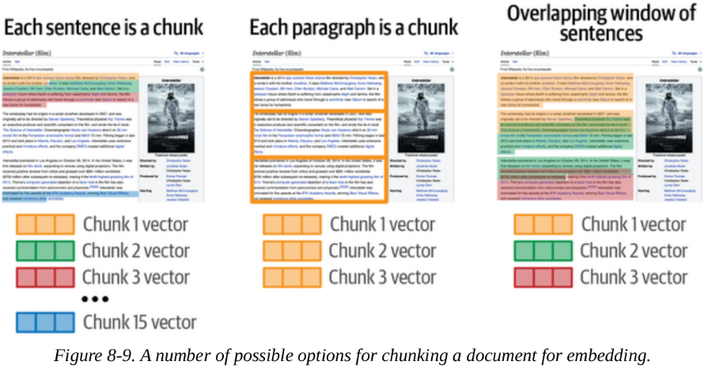
Semantic Search with Language Models
Multiple vectors per document
The best way of chunking depends on the types of texts and queries.

Slide 33
Semantic Search with Language Models
Multiple vectors per document
Was of chunking include:
Each sentence is a chunk.
The issue is that it may not capture the overall context of a document.
Each paragraph is a chunk.
Good if the text already is made of paragraphs (each with its own subcontext within the longer document).
Otherwise, it would just be chunking of 3-8 sentences.

Slide 34
Semantic Search with Language Models
Multiple vectors per document
Was of chunking include:
Some chunks derive meaning from the text around them.
Context can be incorporated by:
adding the title of the document to the chunk
adding some overlap between chunks (words that chunks share in the beginning and the last part of each chunk).

Slide 35
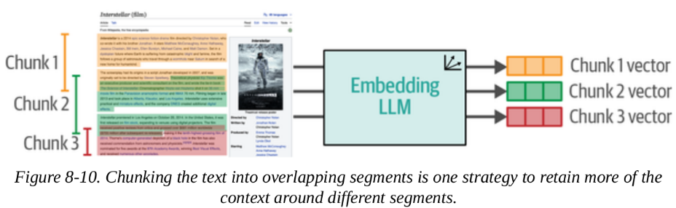
Semantic Search with Language Models
Multiple vectors per document
A visual example of chunking (with overlap) is provided below:

Slide 36
Semantic Search with Language Models
Nearest neighbor search versus vector databases:
Once the query is embedded, we can start looking for results of a query.
This can be done by calculating the distances between the query and the archive.
An efficient approach is to use nearest neighbor search libraries like Annoy or FAISS.
Another way to find the nearest neighbors is by using vector databases like Weaviate or Pinecone.

Slide 37
Semantic Search with Language Models
Fine-tuning embedding models for dense retrieval
We know we can fine-tune a language model to perform a specific
task.
For embedding models, they are fine-tuned to generate better embeddings for retrieval.
The model learns to pull relevant query-document pairs closer together in embedding space, while pushing irrelevant pairs farther apart.

Slide 38
Semantic Search with Language Models
Fine-tuning embedding models for dense retrieval
The embedding model learns what "relevance" means for your specific task or domain.
the fine-tuning process requires training data composed of queries paired with:
relevant documents (positive examples) and queries paired with
irrelevant documents (negative examples).

Slide 39
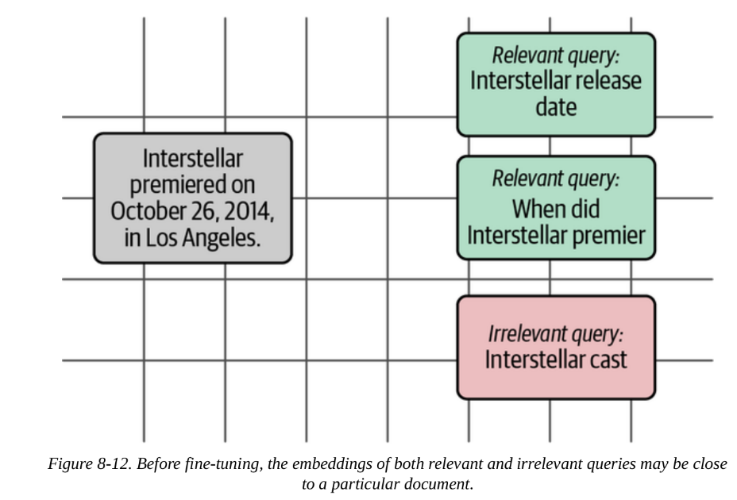
Semantic Search with Language Models
Fine-tuning embedding models for dense retrieval
Below is an illustration of embeddings before fine-tuning:

Slide 40
Semantic Search with Language Models
Reranking
Reranking is tasked with changing the order of the search results based on relevance to the search query.
A reranker takes in the search query and a number of search results, and returns the optimal ordering of these documents so the most relevant ones to the query are higher in ranking.

Slide 41
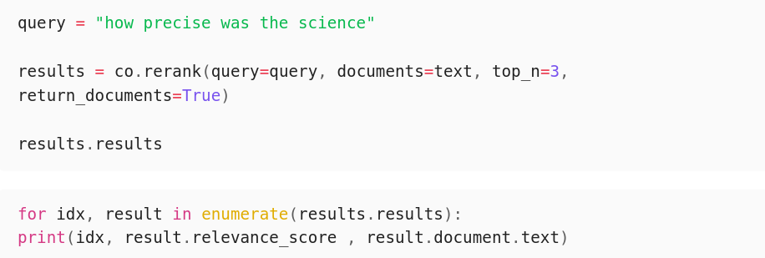
Semantic Search with Language Models
Reranking Example
In the following example, we will use Cohere's Rerank endpoint to start using a reranker.

Slide 42
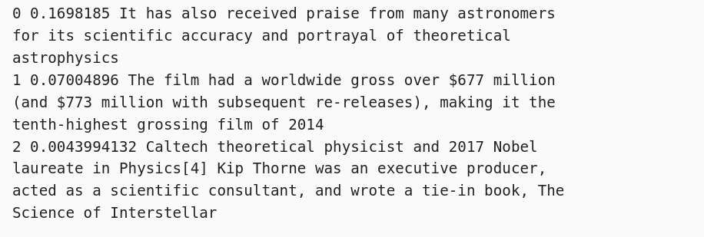
Semantic Search with Language Models
Reranking Example
The following code outputs:
Here, you can see that the reranker shows higher confidence for the first result.

Slide 43
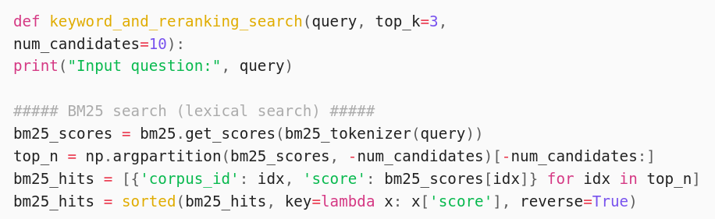
Semantic Search with Language Models
Reranking Example
Let's change our keyword search function so that it retrieves a list of the top 10 results, then use rerank to choose the top 3 from the top 10.

Slide 44
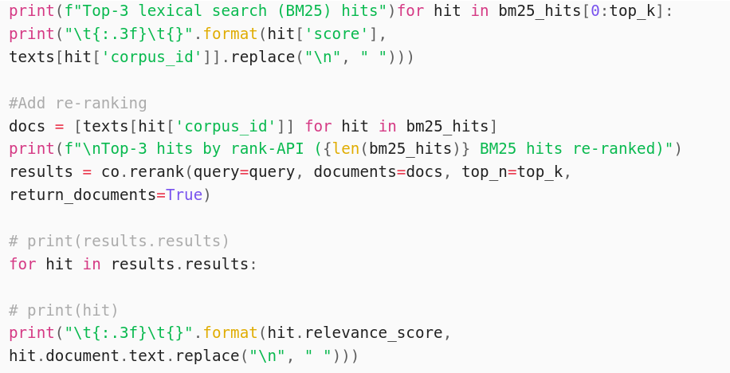
Semantic Search with Language Models
Reranking Example
Let's change our keyword search function so that it retrieves a list of the top 10 results, then use rerank to choose the top 3 from the top 10.

Slide 45
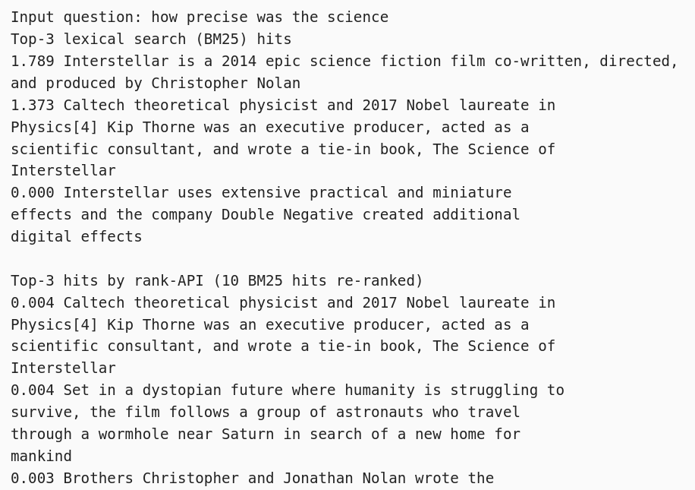
Semantic Search with Language Models
Reranking Example
Results:
We see the top result of the keyword search are not included in the top 3 results of the reranker.

Slide 46
Semantic Search with Language Models
How reranking models work
One popular way of building LLM search rerankers is to present the query and each result to an LLM working as a cross-encoder.
The query and each result retrieved are presented to the LLM at the same time separately so the LLM can can view all the pairs before assigning a relevance score
This score determines the new order of the results.

Slide 47
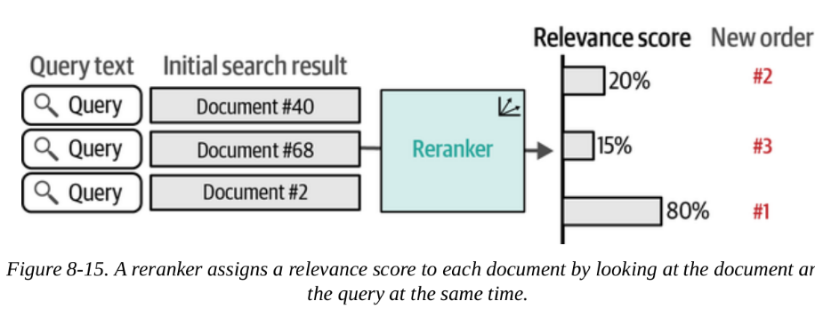
Semantic Search with Language Models
How reranking models work

Slide 48
Semantic Search with Language Models
Retrieval Evaluation Metrics
Semantic search is evaluated using metrics from the Information Retrieval (IR) field.
MAP (Mean Average Precision)
Evaluating search systems needs 3 major components:
a text archive
a set of queries
relevance judgments indicating which documents are relevant for each query.

Slide 49
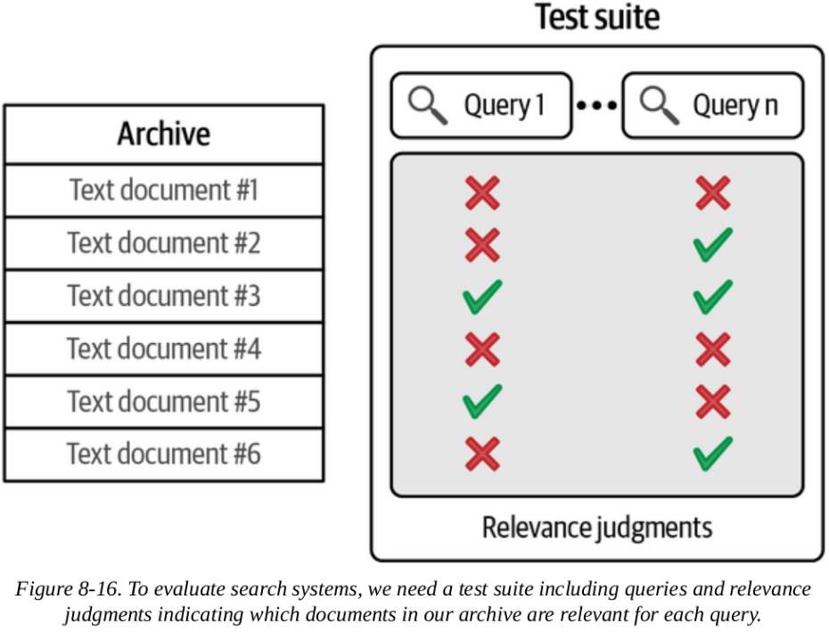
Semantic Search with Language Models
Retrieval Evaluation Metrics
For each query, all text documents have relevance labels.
These labels are either relevant/not relevant. The labels for each text document is called relevance judgments.

Slide 50
Semantic Search with Language Models
Retrieval Evaluation Metrics
Relevance judgments serve as ground truth and are used to see the performance of a search system.

Slide 51
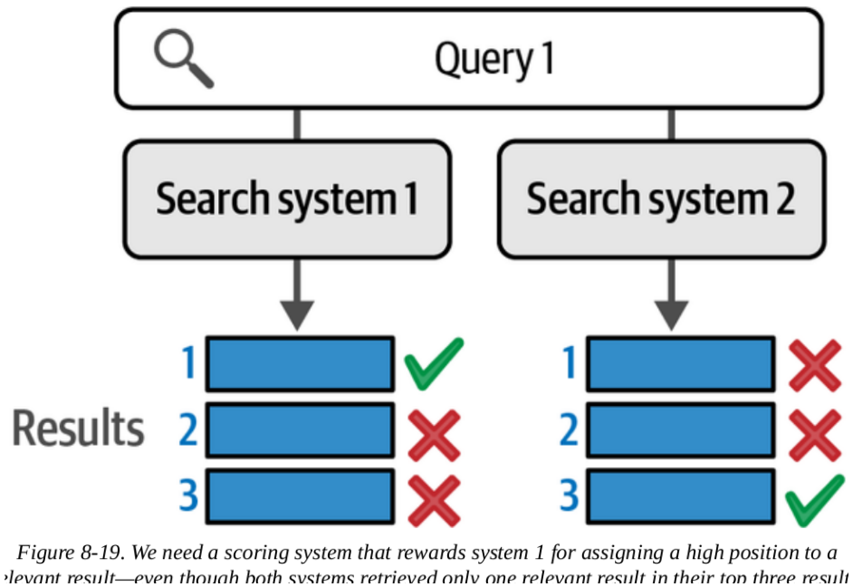
Semantic Search with Language Models
Retrieval Evaluation Metrics
In this example, it is straightforward to know which search system performs better.
What if we need to quantify how much better a search system performs than the other one?
We can use mean average precision (MAP).

Slide 52
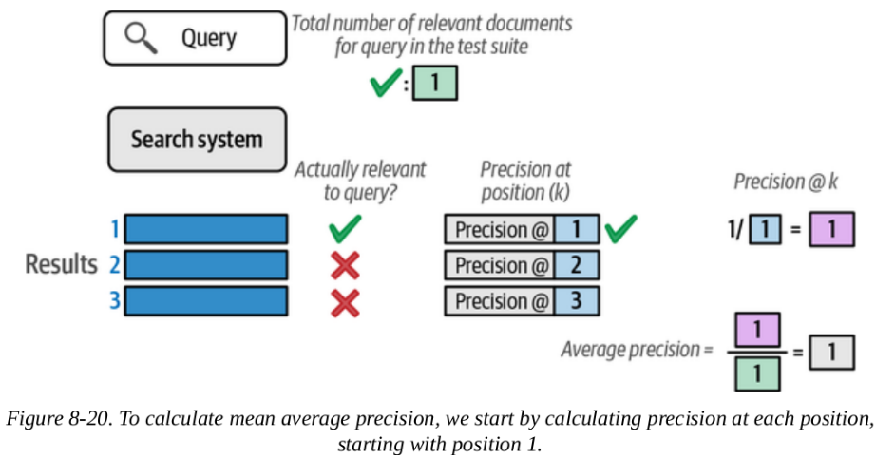
Semantic Search with Language Models
Scoring a single query with average precision
In this case, the search system placed the relevant result (the only available one for this query) at the top.
This gives the system a perfect score of 1.

Slide 53
Semantic Search with Language Models
Scoring a single query with average precision
Looking at the calculation: we're at position 1, we have a relevant result,
so precision at position 1 is 1.0 (it's calculated as the number of relevant results at position 1, divided by the position we're currently looking at, which is 1/1 = 1.0).

Slide 54
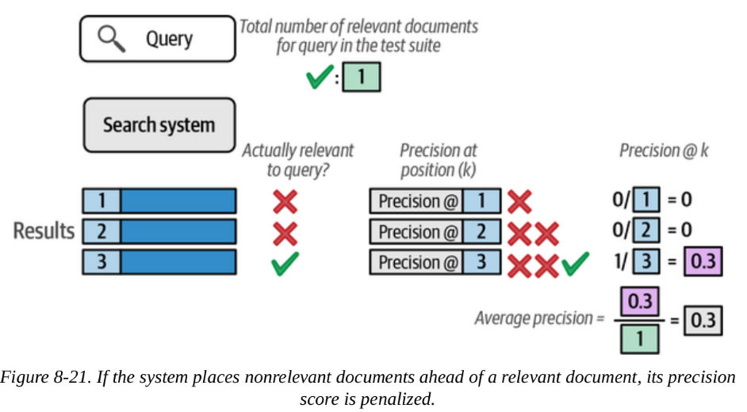
Semantic Search with Language Models
Scoring a single query with average precision
What if the system placed the only relevant result at position 3?
In this case, the system would get penalized.
We have 1 relevant result out of 3 positions, so precision at position 3 = 1/3 = 0.3.

Slide 55
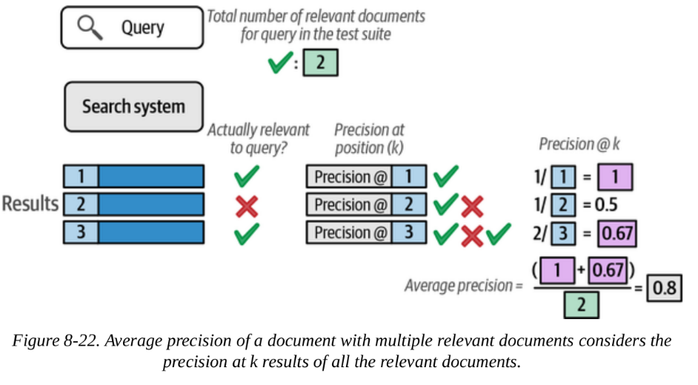
Semantic Search with Language Models
Scoring a single query with average precision
Look at a query with more than one relevant document.
For position 1: precision@1 = 1/1 = 1.0
For position 3: precision@3 = 2/3 = 0.67 (because we've now found 2 relevant docs in 3 positions)
Average precision = (1.0 + 0.67) / 2 = 0.83
The average precision basically calculates how well the system places each result in order (ranks).

Slide 56
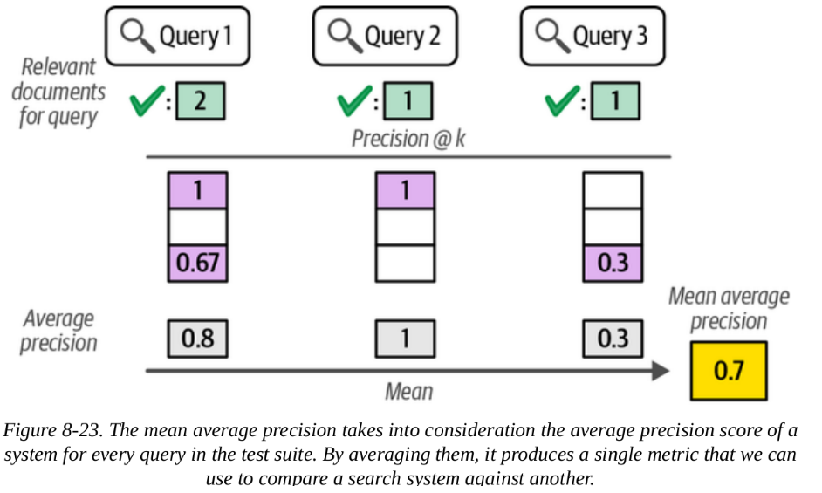
Semantic Search with Language Models
Scoring across multiple queries with mean average precision
A metric that scores a search system against all the queries in the test suite.

Slide 57
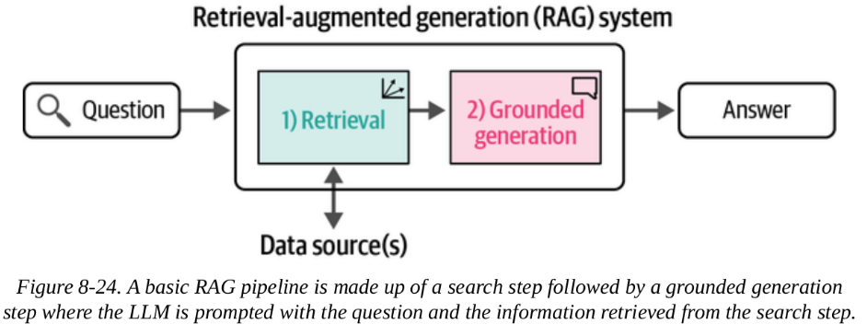
Retrieval-Augmented Generation (RAG)
RAG systems apply the search capabilities discussed previously to generate responses.
Enables users to access and 'chat with' documents.
Helpful for private or personal data the LLM wouldn't have access to otherwise

Slide 58
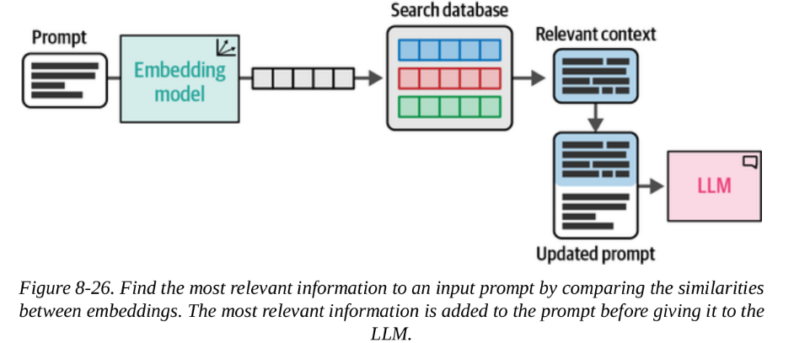
Retrieval-Augmented Generation (RAG)
From Search to RAG
The way to turn a search system to a RAG System is by adding an LLM to the end of the search pipeline.

Slide 59
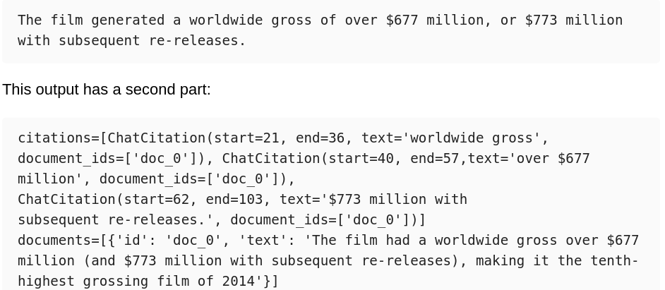
Retrieval-Augmented Generation (RAG)
Example: Grounded Generation with an LLM API
The previous code outputs:

Slide 60
Retrieval-Augmented Generation (RAG)
Example: RAG with Local Models
You'll need:
A generation model (we'll use Phi-3-mini-4k )
An embedding model (we'll use BAAI/bge-small-en-v1.5 )
A vector database (FAISS)
A RAG prompt template with {context} and {question} variables
Just like in previous chapters, we start by downloading the model (Phi-3-mini-4k-instruct):

Slide 61
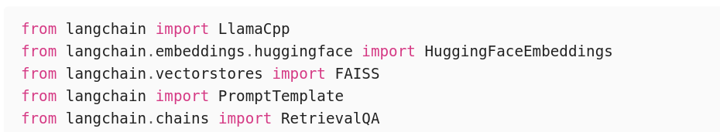
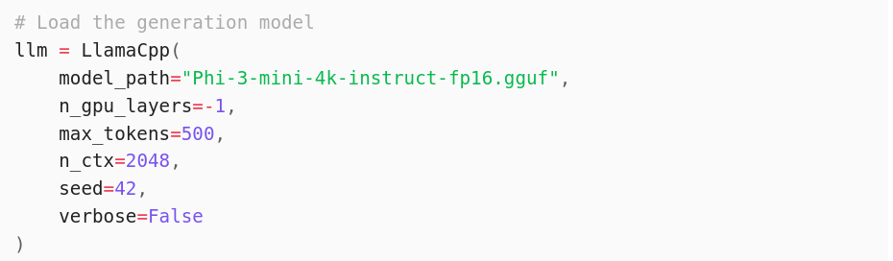
Retrieval-Augmented Generation (RAG)
Example: RAG with Local Models

Slide 62
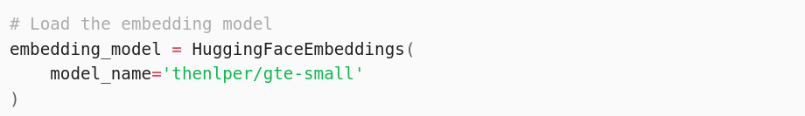
Retrieval-Augmented Generation (RAG)
Example: RAG with Local Models
Loading the embedding model
We can then use the embedding model to set up the vector database:

Slide 63
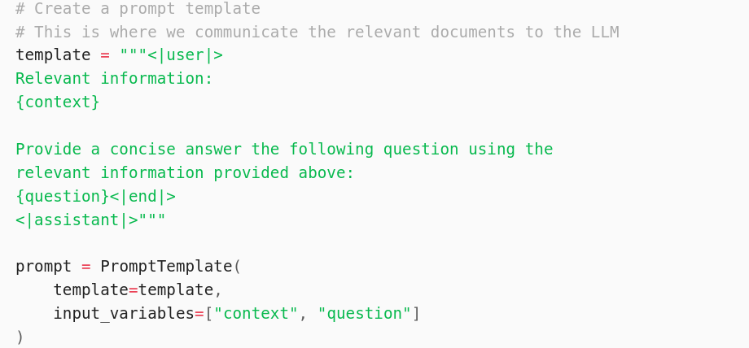
Retrieval-Augmented Generation (RAG)
Example: RAG with Local Models
The RAG Prompt: we would need to create an additional input variable context that can provide the LLM with the retrieved documents

Slide 64
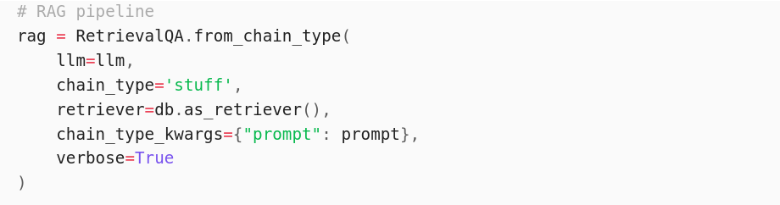
Retrieval-Augmented Generation (RAG)
Example: RAG with Local Models
The RAG Prompt: continuation
Now you can call the model and ask it a question:

Slide 65
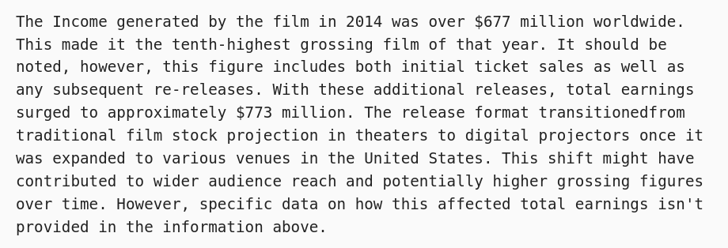
Retrieval-Augmented Generation (RAG)
Example: RAG with Local Models
The RAG Prompt: rag.invoke() outputs:
As always, we can adjust the prompt to control the model's generation (e.g., answer length and tone).

Slide 66
Retrieval-Augmented Generation (RAG)
Advanced RAG Techniques
Additional techniques to improve the performance of RAG systems:
Query rewriting
If the RAG system is a chatbot, the RAG implementation we tried to build earlier would likely struggle if a question is too verbose
Example of a verbose query:
User Question: "We have an essay due tomorrow. We have to write about some animal. I love penguins. I could write about them. But I could also write about dolphins. Are they animals? Maybe. Let's do dolphins. Where do they live for example?"

Slide 67
Retrieval-Augmented Generation (RAG)
Advanced RAG Techniques
Additional techniques to improve the performance of RAG systems:
Query rewriting
This should actually be rewritten into a query like:
Query: "Where do dolphins live"
In this example, the rewriter omitted many parts of the original question that do not help find the relevant document

Slide 68
Retrieval-Augmented Generation (RAG)
Advanced RAG Techniques
Additional techniques to improve the performance of RAG systems:
Multi-query RAG
Extends the query rewriting to be able to search multiple queries if more than one is needed to answer a specific question.
User Question: "Compare the financial results of Nvidia in 2020 vs. 2023"
it is better and safer to use 2 separate queries for a question about two different years:
Query 1: "Nvidia 2020 financial results"
Query 2: "Nvidia 2023 financial results"

Slide 69
Retrieval-Augmented Generation (RAG)
Advanced RAG Techniques
Additional techniques to improve the performance of RAG systems:
Multi-hop RAG
May require a series of sequential queries.
To answer this, the system must first search for:
Step 1, Query 1: “largest car manufacturers 2023”
After it gets this information (the result being Toyota, Volkswagen, and Hyundai), it should ask follow-up questions:
Step 2, Query 1: “Toyota Motor Corporation electric vehicles”
Step 2, Query 2: “Volkswagen AG electric vehicles”
Step 2, Query 3: “Hyundai Motor Company electric vehicles

Slide 70
Retrieval-Augmented Generation (RAG)
Advanced RAG Techniques
Additional techniques to improve the performance of RAG systems:
Agentic RAG
Advanced RAG systems behave more like agents
Capable of using multiple tools and making complex decisions.

Slide 71
Retrieval-Augmented Generation (RAG)
RAG Evaluation
As a new technology, the ways to evaluate RAG are still being developed.
The paper "Evaluating verifiability in generative search engines" (2023) runs human evaluations on different generative systems using four criteria:
Fluency: Whether the generated text is fluent and cohesive.
Perceived utility: Whether the generated answer is helpful and informative.
Citation recall: The proportion of generated statements about the external world that are fully supported by their citations.
Citation precision": The proportion of generated citations that support their associated statements.

Slide 72
Retrieval-Augmented Generation (RAG)
RAG Evaluation
Human evaluation is always preferred
But there are approaches that attempt to automate these evaluations by having a capable LLM act as a judge (called LLM-as-a-judge)
Ragas is a software library that does exactly this. It uses some additional metrics as well:
Faithfulness: Whether the answer is consistent with the provided context
Answer relevance: How relevant the answer is to the question

Slide 73
END

